Slide 1
Expense Object Usage
Calahan McAlister & Beverly Hill
June 4th, 2024

Slide 2
Understanding the Account Number
Example: 11-10-904601-55720
Fund - 11
Function – 10
Cost Center – 904601
Object – 55720

Slide 3
Fund 11-10-904601-55720
What is the designation of the account?
The first number is the overall designation
The second number is the category
Examples:
10 – Current Unrestricted – General Education Appropriated
11 – Current Unrestricted – General Education Local
20 – Current Restricted – Grants and Contracts
21 – Current Restricted – Scholarships
30 – Auxiliary – Athletics
32 – Auxiliary – Residence Halls

Slide 4
Function 11-10-904601-55720
What is the Purpose of the account?
Examples:
00 - General
01 – Instruction
04 – Research
07 – Library
10 – Institutional Support
11 – Academic Support
21 – Scholarships
30 – Auxiliary

Slide 5
Cost Center 11-10-904601-55720
Who oversees the account?
The first 3 numbers are the department
Note* the 4th digit has meaning but will be explained in later training
Examples:
035 -
904 – Controller’s Office
906 – Human Resources
975 – Athletics – Women’s
976 – Athletics – Men’s

Slide 6
Object 11-10-904601-55720
How are the funds held or grouped?
First digit is the classification
1 – Asset ex. 10100 – Cash on Hand
2 – Liability ex. 20609 – Accounts Payable-Payroll
3 – Fund Balance ex. 30000 – Fund Balance (Starting Budget)
* Think Balance Sheet
4 – Revenue ex. 41001 – Registration Fees
5 – Expense ex. 55720 – supplies purchase
* Think Income Statement

Slide 7
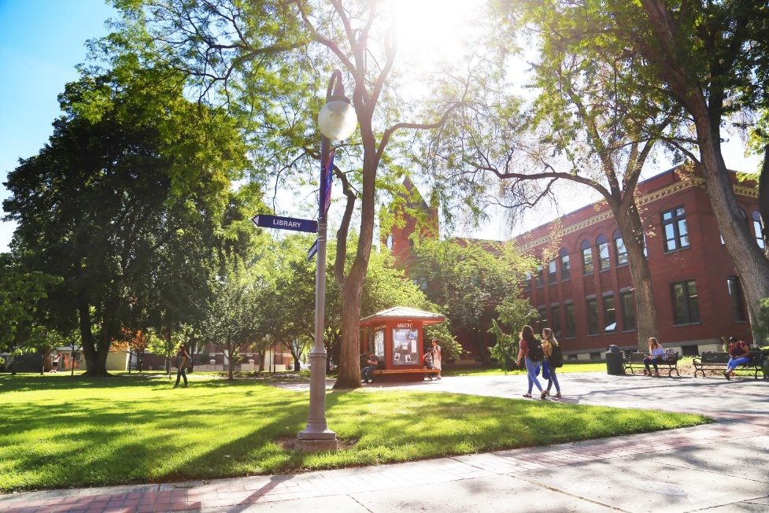
Expense Objects
Services
Travel
Supplies
Misc.
Capital Outlay
Operating
Expenses

Slide 8
Services
5-5030 – Telephone & Equipment
5-5150 – Services
5-5180 – Promotions & Publicity
5-5181 – Donation or Sponsorship NonGov
5-5199 – Independent Contractor Services
5-5210 – Software Subscriptions < $5k
5-5241 – IT Services
5-5285 – Software Subscriptions > $5k
5-5275 - Printing

Slide 9
Travel
5-5353 – Partial Day Reimbursement
5-5396 – Employee Travel

Slide 10
Supplies
5-5570 – One-Time Software < $5k
5-5580 – Computer Equipment < $2k
5-5650 – Repair & Maintenance
5-5670 – Food
5-5720 - Supplies

Slide 11
Misc
5-5940 – Rentals
5-5995 – Inter-Departmental Expenses
5-5999 – Misc. Expenses

Slide 12
Capital Outlay
5-6410 – Computer Equipment $2k-$4,999
5-6420 – One-Time Software > $5k
5-6499 – Computer Equipment > $5k
5-6520 – Capital Outlay

Slide 13
Expense Object
Most Commonly used
Most commonly mis-used
P-Card Object Review

Slide 14
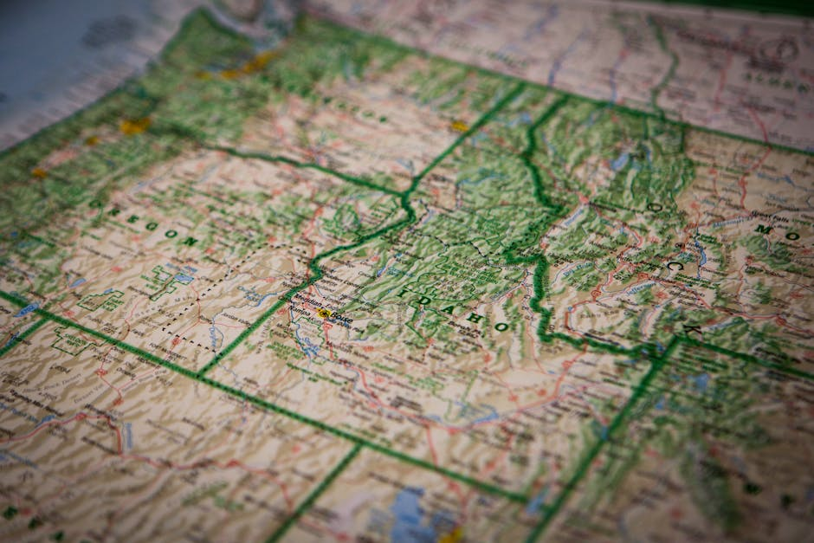
Travel Updates July 1

Slide 15
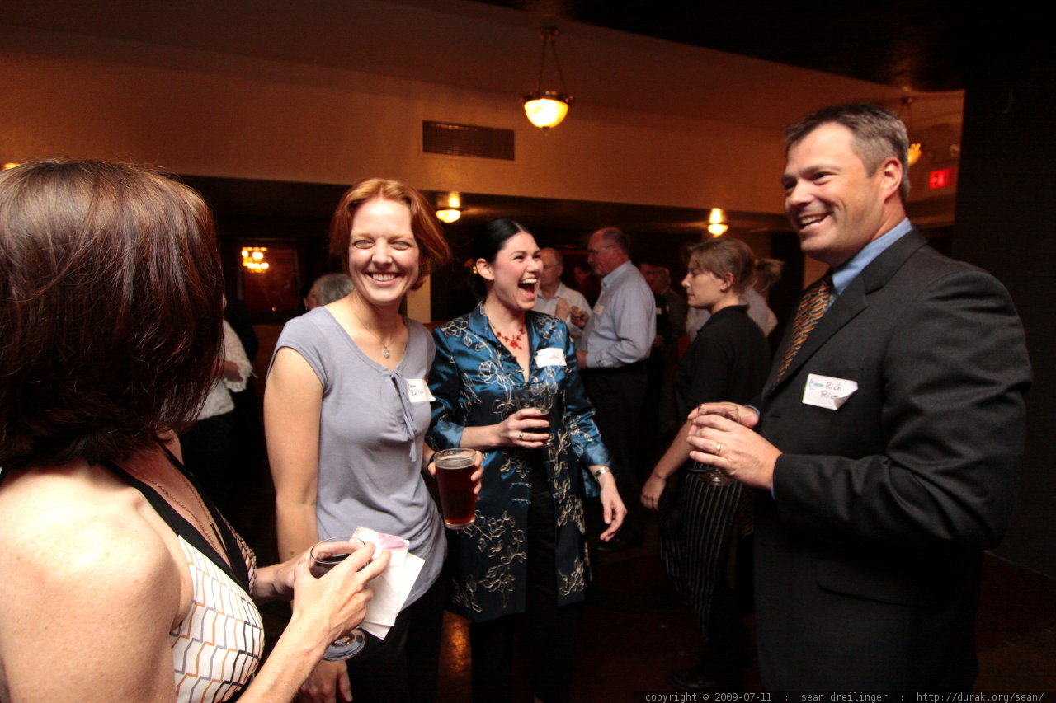
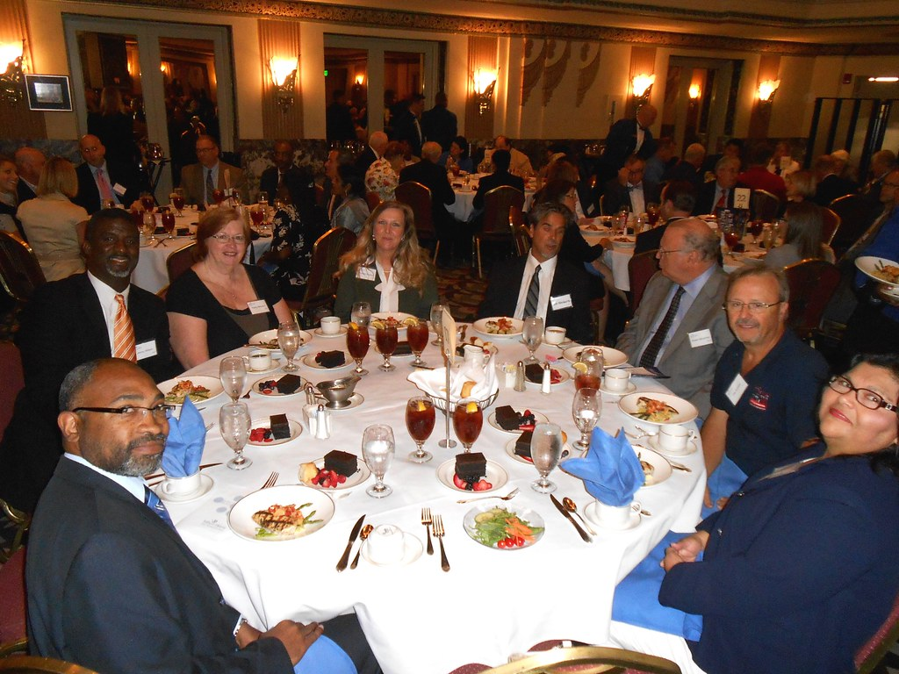
MER/PRR UPDATES

Slide 16
A/P
https://www.lcsc.edu/media/12622/how-to-attach-an-invoice-to-po-and-notify-ap.pdf
For A/P please add Amanda Taylor, Catherine O'Shaughnessy, and Calahan McAlister (Temp for now)
Please comment and tag AP team when receipted (proper QTY and what was received)
For Check Request Other (Use with AP/Purchasing Approval Only)
Look at Monday Message for summer newsletter

Slide 17
Thank you. Questions?
Calahan McAlister
Beverly Hill

